Slide 1

Data Analytics
Project Workflow
Hospital Emergency Room Management Dashboard

Slide 2

PURPOSE OF PROJECT
We created Hospital Emergency Room Analysis Dashboard in Excel to improve efficiency and provide useful insights. This dashboard will help stakeholders monitor, analyze, and make better decisions for managing patients and improving services.

Slide 3

Project Steps
Business Requirement Gathering
Understanding of Data
Data Connection (Import Data Using Power Query)
Data Cleaning and Data Quality Check Using Power Query
Creating Calendar Table using Power Query
Data Modeling – Power Pivot
Adding Required Columns (DAX Calculation in Power Pivot)
Creating Pivots and Dashboard Lay outing
Charts Development and Formatting
Dashboard / Report Development
Insights Generation

Slide 4
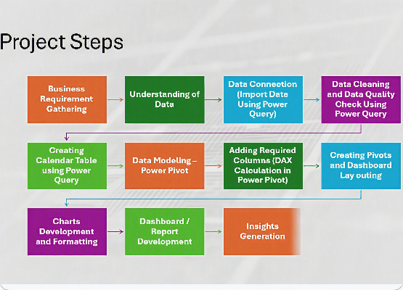
End-to-End Workflow
A structured approach ensures that data is accurately transformed from raw sources into actionable business insights. This 11-step process is divided into three key phases:
•
Phase 1: Data Connection & Cleaning
•
Phase 2: Modeling & Calculations
•
Phase 3: Visualization & Reporting
Reference the flowchart on the right for the chronological progression of tools and methodologies.

Slide 5











Phase 1: Data connection & Cleaning
Business Requirement Gathering
Understanding of Data
Data Connection
Data Cleaning & Quality Check
Engage with stakeholders to understand objectives, key metrics, and the core questions the dashboard needs to answer.
Analyze the raw data formats, structures, and relationships before beginning any technical ingestion processes.
Establish secure connections and import data effectively utilizing the Power Query engine.
Use Power Query to clean messy data, remove duplicates, and ensure robust data quality standards.

Slide 6










Phase 2: Modeling & Calculations
Creating Calendar Table
Data Modeling
Adding Required Columns
Creating Pivots & Layout
Generate a central Calendar Table in Power Query to enable advanced time-intelligence tracking.
Establish relationships and build a structured data model utilizing the Power Pivot engine.
Write essential DAX calculations in Power Pivot to create powerful custom measures and metrics.
Draft the initial dashboard layout and construct PivotTables to validate logic and calculations.

Slide 7








Phase 3: Visualization & Insights
Charts Development & Formatting
Dashboard / Report Development
Insights Generation
Transform raw data tables into clear, visually appealing charts and apply consistent formatting rules.
Assemble charts, slicers, and interactive elements into a cohesive, user-friendly reporting interface.
Analyze the completed dashboard to derive actionable insights and strategic recommendations for the business.

Slide 8
KPI’S Requirement
Number of Patients:
Count the total number of patients visiting the ER each day.
Show a daily trend with an area sparkline to spot patterns like busy days or seasonal trends.
Average Wait Time:
Find the average time patients wait to see a medical professional.
Use an area sparkline to track daily changes and highlight days with longer wait times that might need improvements.
Patient Satisfaction Score:
Check the average daily satisfaction score of patients to assess service quality.
Use an area sparkline to show trends, spot drops in satisfaction, and link them to busy times or challenges.

Slide 9
DAX Formulas
Calendar Table Formula
= List.Dates(#date(2023,01,01),731,#duration(1,0,0,0))
DAX Formula for Age Group :
=IF([Patient Age]>=70,"70-79",IF([Patient Age]>=60,"60-69",IF([Patient Age]>=45,"45-59",IF([Patient Age]>=30,"30-44",IF([Patient Age]>=15,"15-29",IF([Patient Age]>=5,"05-14","0-4"))))))
DAX Formula For Patient Attend Status :
=IF([Patient Waittime]<30,"Within Time","Delay")

Slide 10
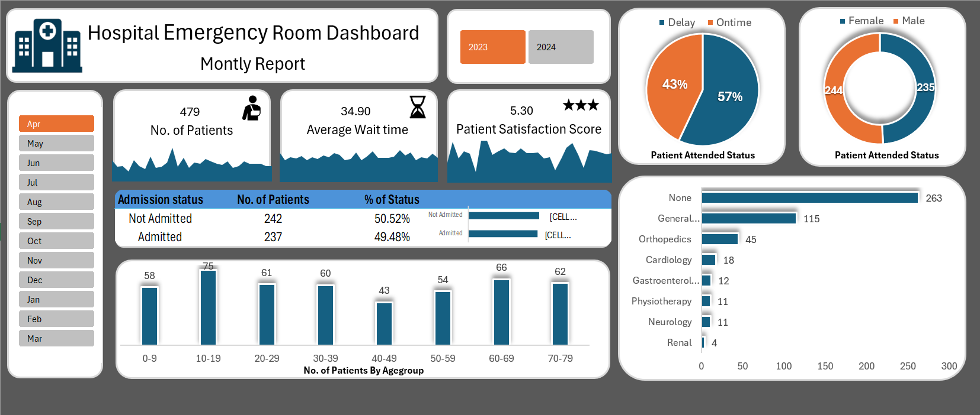
FINAL DASHBOARD

